Slide 1
Annual Information Session
for Public Schools

Slide 2
What is College Credit Plus?
College Credit Plus is Ohio’s dual credit program
  Students can earn high school and college credit at the same time
  Ohio residents in grades 7-12; enrolled at a public/private high school or homeschooled
  Take a variety of courses at any public and participating private college in Ohio
  Courses held at the high school, on a college campus, or online
ORC 3365.02, ORC 3365.03
Notes:
Additional Notes for Presenters:
Students in the state of Ohio only
Variety of college courses available, HS credits can meet graduation requirements
3+ college credit hours = 1 HS unit
All public colleges/universities in Ohio, some private colleges, very few eligible out-of-state
Take classes in fall, spring or summer
Adhere to policies/requirements of college

Slide 3
How can students participate?
  Step 1: Eligibility
  A student is eligible for the College Credit Plus program if the student meets any of the following criteria:
    Obtains a remediation-free score on one of the standard assessment exams
    Has a cumulative unweighted high school grade point average of at least 3.00
    Has a cumulative unweighted high school grade point average of at least 2.75 but less than 3.00 and received an "A" or "B" grade in a relevant high school course.
ORC 3365.03, OAC 3333-1-65.14
Notes:
Additional Notes for Presenters:
Must meet only one, “multiple measures” of eligibility
Remediation free scores on ACT, SAT, Accuplacer, ALEKS, PlaceU, MapleSoft
May differ from tests taken for course placement

Slide 4
How can students participate?
Step 2: College Admission
Students must apply for admission at each institution
  Admission is reviewed per the requirements of the college or university; contact the college to find specific information
College applications include the permission slip for mature content and a questionnaire about emotional maturity
Colleges have the final decision on student admission
ORC 3365.05, 3365.035, OAC 3333-1-65.3

Slide 5
How can students participate?
Step 3: Course Registration
The college will discuss course options with the student, based on assessment scores, prerequisites, and other requirements
School counselors can help students understand graduation requirements and CCP course substitutions
High schools and colleges develop 15 and 30 credit hour pathways to help you determine your plan
ORC 3365.13
Notes:
Additional Notes for Presenters:
Students work with both a college advisor and their HS counselor to plan their courses
Some HS may have additional graduation requirements beyond the state requirements
Students are not limited to only taking courses on the pathways, they just exist as a guide/resource

Slide 6
Course Eligibility Rules
Students must complete their first 15 credits in Level I courses, which include:
Transferable courses
Courses in IT, Computer Science, Anatomy & Physiology, foreign language
Courses that are part of a technical certificate
Courses that are part of a 15- or 30-credit pathway
Courses in study skills, academic or career success
Notes:
Additional Notes for Presenters:
Colleges must post their Level 1 courses
Students can move on to Level II courses after completing 15 credit hours of Level I
Level II courses are any other allowable college courses that they meet the prerequisites for

Slide 7
Course Eligibility Rules
Non-allowable courses include:
Private applied courses with one-on-one instruction (such as performing art lessons)
Courses with high fees
Study abroad courses
Physical education courses
Pass/Fail graded courses
Remedial courses or sectarian/religious courses
OAC 3333-1-65.12, ORC 3365.13

Slide 8
How many classes can students take?
Students may be enrolled in up to 30 credits per year, which includes high school courses:
Calculation: 30 – (HS units x 3) = max CCP credit hours
The maximum number of college credits a student can complete while participating in the program is 120
If a student enrolls in more than 30 credits for the year, they can:
  Drop the course prior to the no-fault withdrawal date
  Pay for the entire course at the college’s standard rates (Option A)
OAC 3333-1-65.12, ORC 3365.13
Notes:
Additional Notes for Presenters:
The HS is responsible for calculating hours each year
The 30 credits per year is calculated with both HS and college credits; the 120 hours for the program is college credit only
Students who exceed 30 hours per year and choose to self pay would pay the college’s standard rate and the cost includes tuition, fees, and books
More info on option A later in presentation

Slide 9
Additional Considerations
Grades
  The final grades earned in the college course are the same grade that will be on the high school transcript
    CCP course grades will be factored into the high school and college GPAs
Grade Weighting
  High schools must weight all advanced standing courses in a subject area consistently(CCP, AP, IB, Honors)
ORC 3365.12, OAC 3333-1-65.2

Slide 10
Additional Considerations
Selective Service
Male students who are at least 18 years of age and Ohio residents are required to be registered with the Selective Service System
Students are required to provide their Selective Service number to the public college or university within 30 days of their 18th birthday
Failure submit the Selective Service number will result in the student not being considered a College Credit Plus participant for that semester or term
  The student will be responsible for any tuition, textbooks, or fees associated with the course(s)
ORC 3345.32
Notes:
Additional Notes for Presenters:
- Some schools post a fee for students that fail to comply with selective service requirements

Slide 11
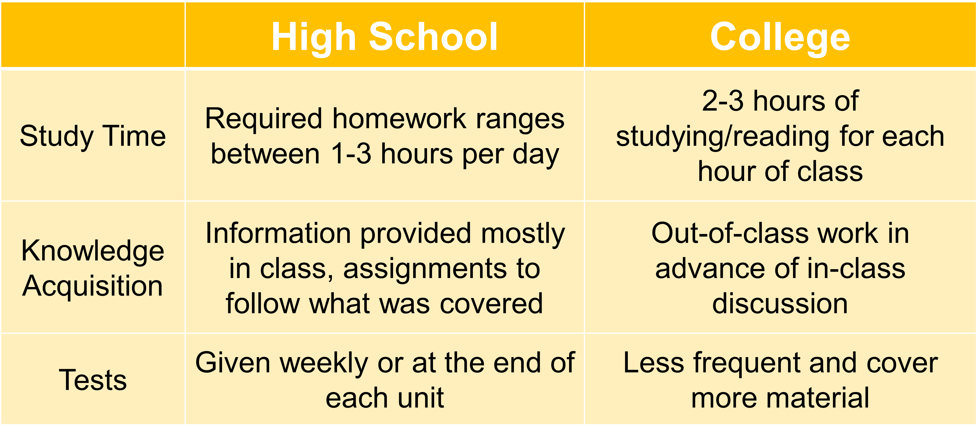
What are differences between high school & college?

Slide 12
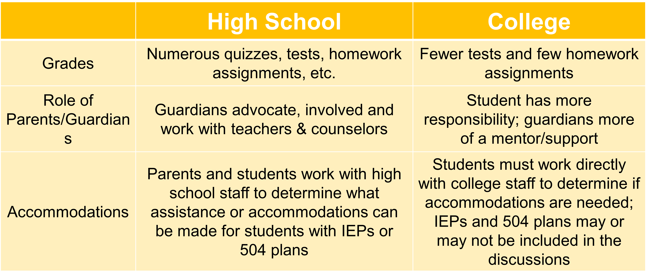
What are differences between high school & college?

Slide 13
What does it mean to be “college-ready”?
Being “college-ready” is more than just being academically ready
Consider emotional and social transition and college expectations
Consider time management and organizational skills

Slide 14
What are benefits of participating in College Credit Plus?
Students can:
  Earn high school and college credits at the same time
  Get a head start on career planning and earn degrees or certificate completions
  Experience college early to understand the expectations of college life
  Save tuition and textbook costs
Notes:
Additional Notes for Presenters:
Students get more flexibility in taking courses that interest them
Utilizing pathways can help cut down time to earning a degree
Many students are now graduating with a certificate, associates degree, or bachelor’s degree when they graduate HS

Slide 15
What are the consequences of underperforming?
Families may be asked to reimburse courses if:
The student does not earn a passing grade in their course
The student withdraws after the no-fault deadline at the college
NOTE: A student that is considered “economically disadvantaged” can not be asked to reimburse the cost of the course(s)
ORC 3365.09, 3365.091; OAC 3333-1-65.13

Slide 16
What are the consequences of underperforming?
College Credit Plus Probation
A student will be placed on CCP probation if:
  They earn less than a cumulative 2.0 GPA in CCP courses or
  They withdraw from 2 or more courses in one academic term
ORC 3365.09, 3365.091; OAC 3333-1-65.13

Slide 17
What are the consequences of underperforming?
While on CCP Probation, the student:
May only enroll in one College Credit Plus course for one college term (semester or quarter)
May not enroll in a college course in the same subject in which student previously earned D, F, NC grade (or equivalent grade)
If students on CCP probation do not increase their CCP GPA to a 2.0 or above during the probation term, they will be placed on CCP Dismissal
ORC 3365.09, 3365.091; OAC 3333-1-65.13

Slide 18
What are the consequences of underperforming?
College Credit Plus Dismissal
If a student does not raise their grade during the probation term, they are dismissed from CCP
While on CCP Dismissal, students may not enroll in any College Credit Plus courses
A student can request (appeal) to be reinstated in the program
ORC 3365.09, 3365.091; OAC 3333-1-65.13

Slide 19
What are the consequences of underperforming?
Appeals for Underperformance:
CCP Probation:
  Student may appeal to take a course in the same subject in which they previously earned a non-passing grade or received no credit
CCP Dismissal:
  Within 5 days of being dismissed, the student may submit an appeal to the secondary school to appeal CCP Dismissal or the student may appeal at the end of the CCP Dismissal semester
Note: Each school district must have a policy describing the process for appeals
ORC 3365.09, 3365.091; OAC 3333-1-65.13

Slide 20
What are the consequences of underperforming?
After HS Graduation:
Grades earned in CCP will remain on students’ college transcripts permanently
If students fail or withdraw often, future financial aid may be also impacted negatively
  Satisfactory Academic Progress (SAP) is a requirement for financial aid
  Standards vary by institution
ORC 3365.09, 3365.091; OAC 3333-1-65.13

Slide 21
What are the expenses for College Credit Plus?
Option A:
The family/student can choose to self-pay for college courses at the standard rate of tuition, fees, and textbooks
  Students/families should arrange a plan for payment with the college or university
Students can choose to earn college credit and high school credit OR only college credit
  Students must inform the school of their choice of credit for courses
ORC 3365.06
Notes:
Additional Notes for presenters:
Families must confirm with both the college and high school if they choose Option A
The deadline to choose is the college’s no fault withdraw date

Slide 22
What are the expenses for College Credit Plus?
Option B:
The “default” or standard option for College Credit Plus
All college course tuition, fees, and textbooks will be paid by the state of Ohio
  Supported by the school’s foundation funds and the college’s funds
Students will earn college credit and high school credit
ORC 3365.06
Notes:
Additional Notes for Presenters:
The default choice, but families can still confirm their choice of Option B by the no fault withdraw deadline
Students may be asked to confirm during the college advising process

Slide 23
What are support services are available for students?
Students receive support from both the HS and College:
High school counselors continue to provide assistance to all College Credit Plus students
College advisors provide course selection assistance
Colleges must provide the same academic supports to CCP students such as tutoring, library access, advising, etc.

Slide 24
What about athletic eligibility?
Student athletes should:
Learn the Ohio High School Athletic Association (OHSAA) requirements
Know that summer term CCP courses cannot be used to bring a student into compliance with the OHSAA requirements for interscholastic athletic participation

Slide 25
Will the course credits transfer?
Certain general education and technical courses will transfer, especially from one Ohio public college to another Ohio public college
Students must check with colleges to confirm transferability
Students should also visit https://transfercredit.ohio.gov for transfer information

Slide 26
What are the deadlines?
Intent to Participate
April 1: complete and return the form to the school office
Check ACT and SAT testing dates
Test early to meet college/university admission deadlines (if required)
Semester deadlines
Summer semester deadline will be early as classes usually start in May
Check with the college for all other semester deadlines

Slide 27
Next Steps
Contact the college and discuss assessment testing requirements
Complete the Intent to Participate form and provide to the school office by April 1
Apply for admission at the college of choice by the deadline
Meet with your school counselor to discuss scheduling and graduation requirements

Slide 28
Do you have other questions?
Visit the CCP website for additional resources:
https://highered.ohio.gov/initiatives/access-acceleration/college-credit-plus
Follow up with the ODHE CCP Team:
CCP@highered.ohio.gov

Slide 29

GCCC Process Overview Class of 2026
  Complete GCCC CCP Intent form by April 1st
  Option 1 - Choose the CCP classes you want to take at GCCC during the day as part of your regular schedule
  CCP Coordinator will register you for courses offered at GCCC
  Ensure that you meet eligibility requirements for courses and student is responsible for scheduling placement testing (if required)
  If you have submitted the Tech Prep application, Sinclair can transfer your Tech Prep application to a CCP application
  If you have not submitted your Tech Prep application with Sinclair, you will need to submit a CCP application before registration can occur
  If you are registering for a course with Clark State, you will need to make sure you complete a CCP application before registration can occur

Slide 30
GCCC Process Overview Class of 2026 cont.
  Option 2 – Choose CCP courses that you want to take on your own
  Ensure that you meet eligibility requirements for courses and student is responsible for scheduling placement testing (if required)
  Complete registration for courses by deadlines designated by the college/university
  Give CCP coordinator and counselor a copy of course schedule before the start of school/term to ensure proper placements and that graduation requirements are being met

Slide 31
GCCC Process Overview Class of 2027
  Complete GCCC CCP Intent form by April 1^{st*}
  *Exceptions can be made to the April 1st deadline for students admitted to GCCC after April 1st
  Option 1 - Choose the CCP classes you want to take at GCCC during the day as part of your regular schedule
  Complete CCP application for Sinclair and/or college/university attending for upcoming term
  CCP Coordinator will register you for courses offered at GCCC
  Ensure that you meet eligibility requirements for courses and student is responsible for scheduling placement testing (if required)

Slide 32
GCCC Process Overview Class of 2027 cont.
  Option 2 – Choose CCP courses that you want to take on your own
  Complete CCP application for Sinclair and/or college/university attending for upcoming term
  Ensure that you meet eligibility requirements for courses and student is responsible for scheduling placement testing (if required)
  Complete registration for courses by deadlines designated by the college/university
  Give CCP coordinator and counselor a copy of course schedule before the start of school/term to ensure proper placements and that graduation requirements are being met

Slide 33

Apply to our College Credit Plus Partners
Class of 2026 – if you applied as Tech Prep student, you do not need to apply again. Sinclair will flip your application to CCP
Class of 2026 – if you have not applied as Tech Prep, you will need to apply at www.Sinclair.edu and complete CCP application
Class of 2027 – if you have applied for CCP at your home school, you do not need apply again. Sinclair will change your school to GCCC
Class of 2027 – if you have not applied for CCP, you will need to apply at www.Sinclair.edu and complete CCP application and list GCCC is the school you are attending

Slide 34

Apply to our College Credit Plus Partners
Class of 2026 – if you are not currently taking CCP courses at Clark State, you will need to complete the CCP application with Clark State at www.clarkstate.edu and select High School Programs
Class of 2027 – if you are currently taking CCP courses at Clark State, you not need to reapply. Clark State will change your school to GCCC. If you are not currently taking courses, please follow the steps above to apply.

Slide 35
GCCC Course Daily Schedule
  GCCC operates on an 8 period bell schedule
  Students are enrolled in their Lab for 3 periods
  Students have 4 periods available for academic courses
  Students will have the option to have one open period available on campus if they are taking a CCP course off campus
  Students will have the option to arrive late or leave early if they are taking CCP courses off campus
  Options for an open period, late arrival, and leaving early will be evaluated on a case by case basis and is subject to approval from CCP coordinator, the student’s counselor, and an administrator.

Slide 36
GCCC Offers Additional College Credits in other ways too! Talk with your lab instructor about:
  CTAG – Statewide college credit earned through CTE End-of-Course assessments a.k.a “WebXam”
  ITAG – Statewide college credit earned through passing Industry Recognized Credentials
  Articulated Coursework – Credit at a particular college for courses

Slide 37
Mrs. Hannen mhannen@greeneccc.com Advanced Engineering Systems, Advanced Industrial Robotics, Auto Collision Repair, Automotive Technology, Aviation Maintenance, Culinary Arts, Drone & UAS Technology | Mrs. Richardson arichardson@greeneccc.com Construction Technology, Electrical Wiring & Motor Controls, HVAC/R, Natural Resource Technology, Welding & Metal Fabrication
Mr. Prather bprather@greeneccc.com Criminal Justice, Health Science Academy, Sports & Exercise Science | Mrs. Scarbro lscarbro@greeneccc.com Career X, Cosmetology, Cybersecurity, Digital Design & Development, Information Technology, Veterinary Science, Video & Animation

